Slide 1
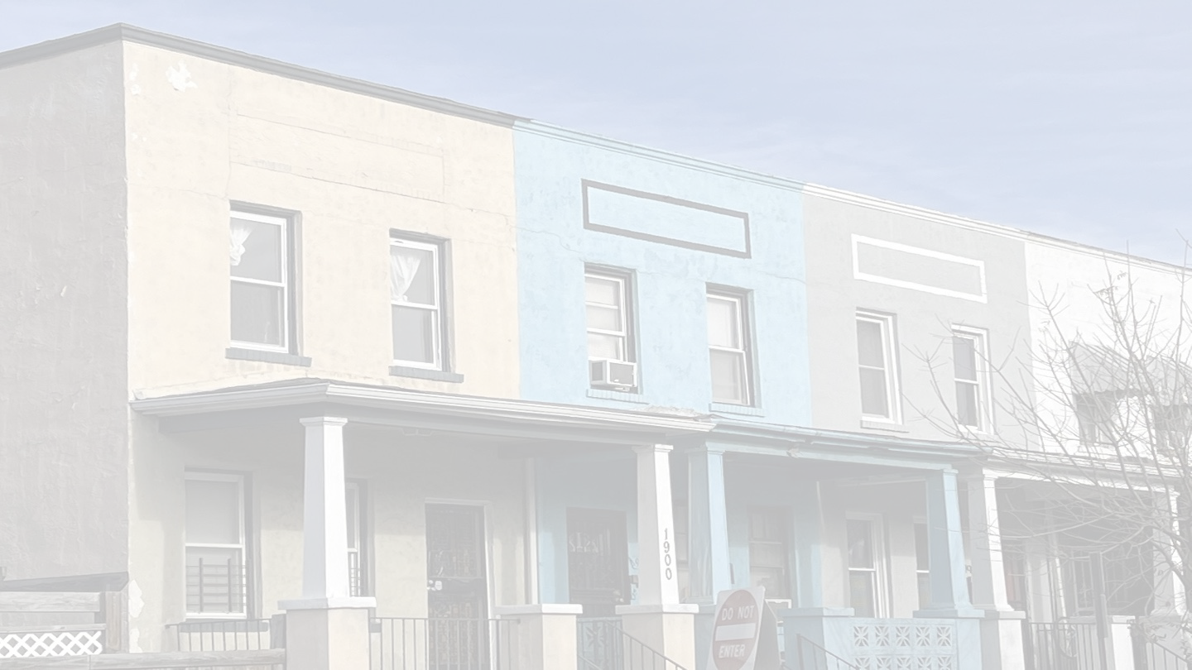
Responding to Gentrification?
311 Call Resolution Times and Neighborhood Change
in Washington, DC
Danielle Corcoran and Jeremy Joy
GOVT 670 Final Project
December 7, 2022

Slide 2
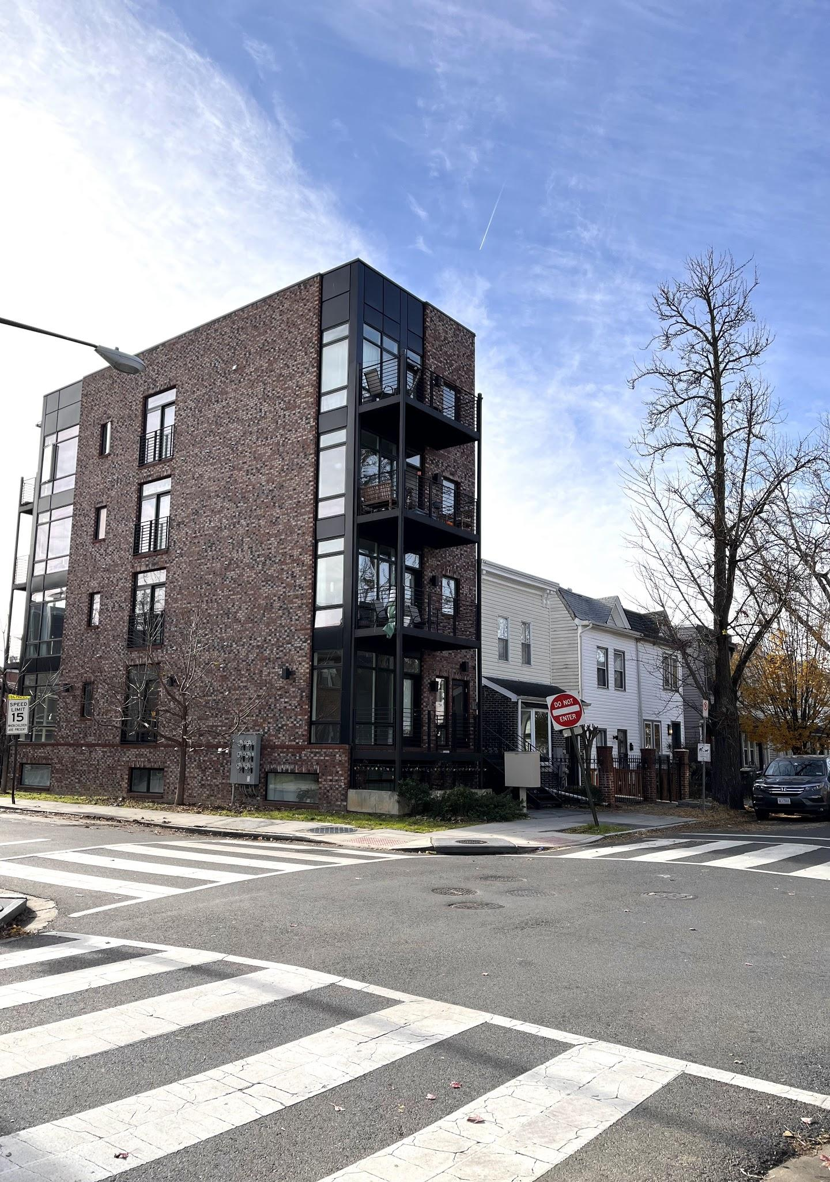
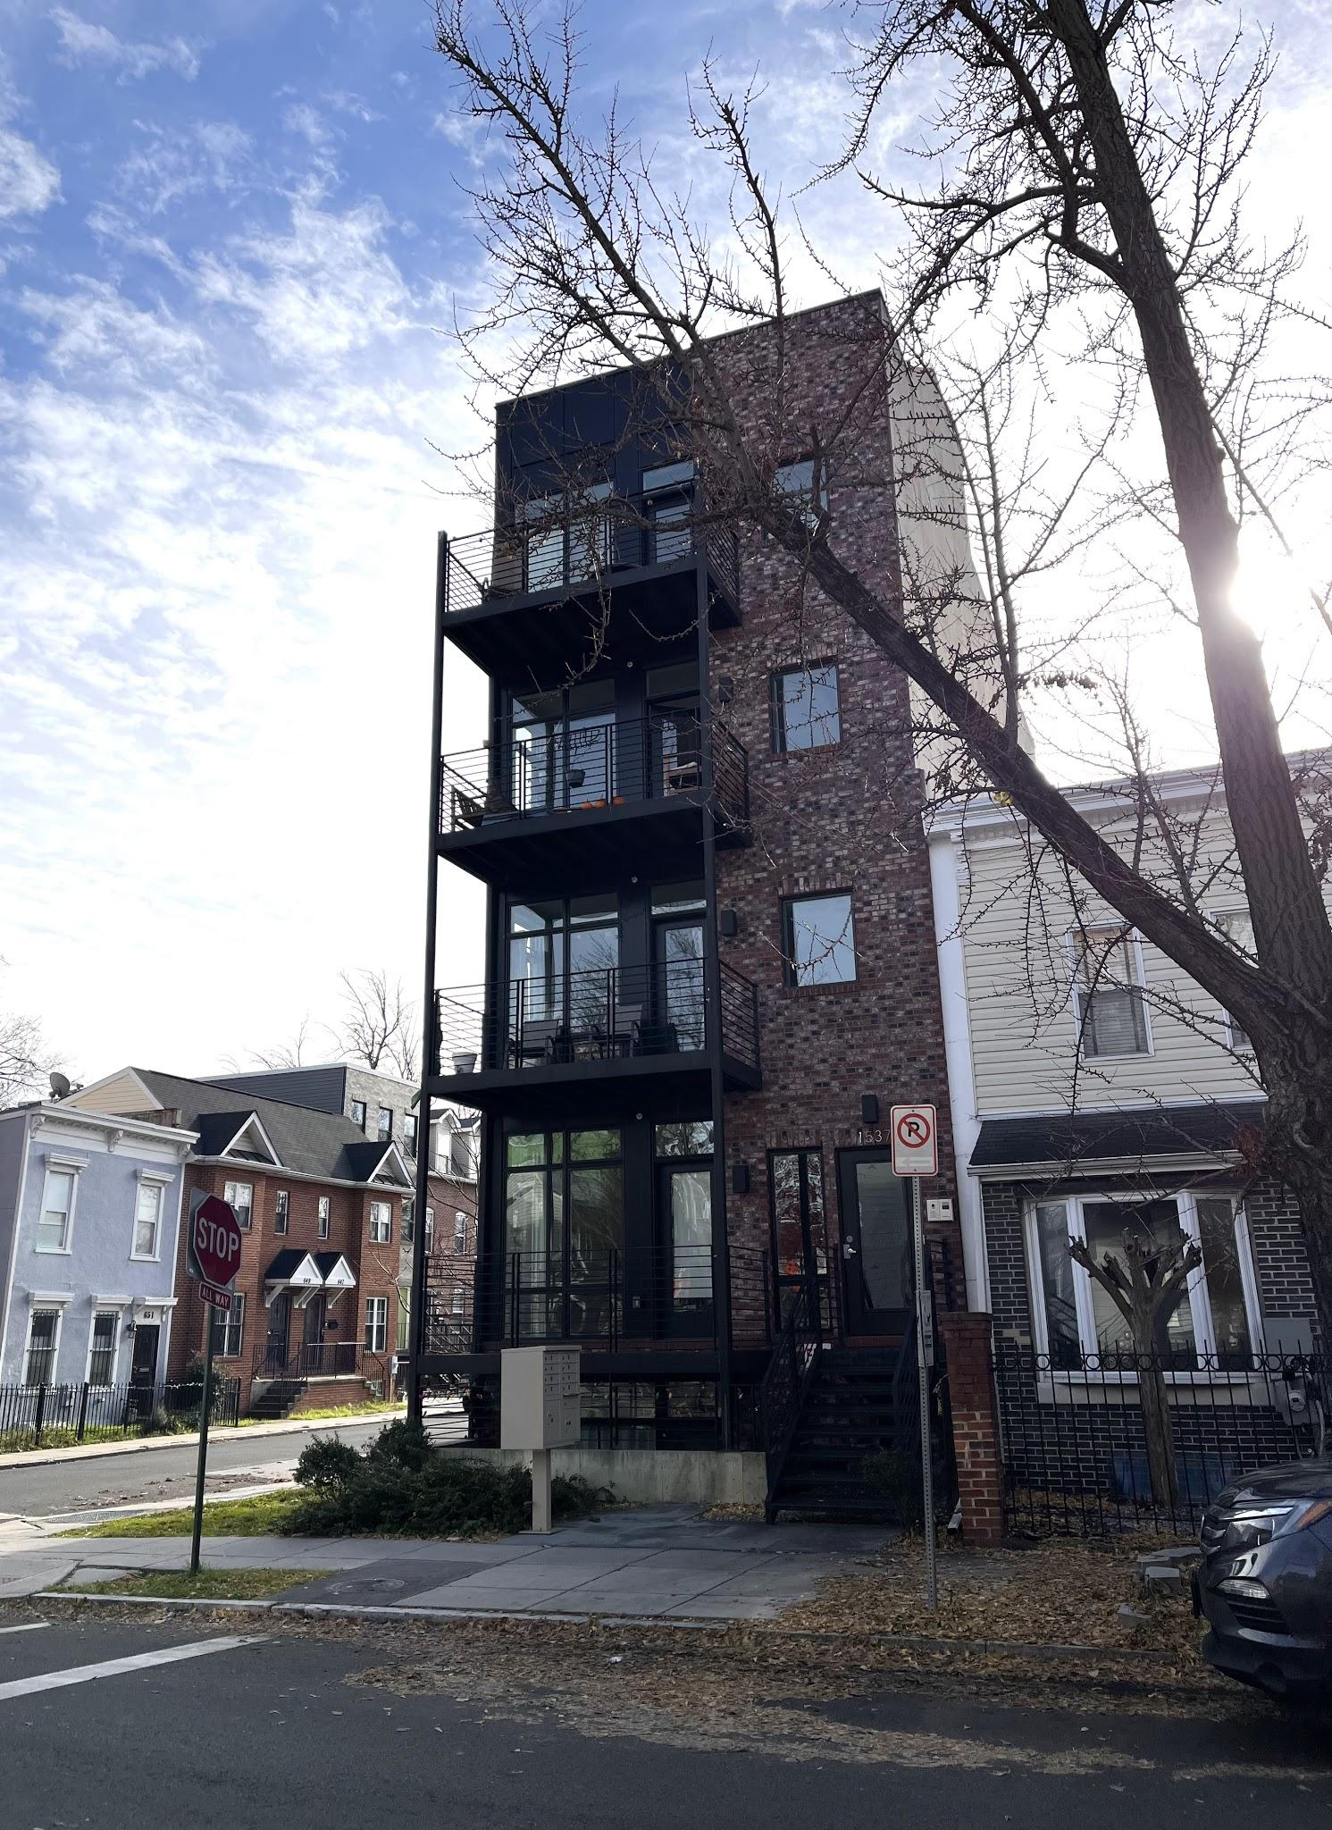
Research question:
Does gentrification reduce resolution times for common 311 service requests?
Hypothesis:
Census tracts that gentrified experienced a greater decrease in resolution times from 2012 to 2019 than tracts that had the potential to gentrify but did not.

Slide 3
Defining gentrification
Common definitions
Criteria (usually 1-3 of these):
Median household income
Median home value
Median rent
Percent of adults over 25 with a Bachelor’s degree
Percent of housing stock under 20 years old
Cutoffs:
Eligibility: below the 40th or 50th percentile
Gentrified: relative growth above the 50th or 67th percentile
Our definition
Criteria:
Median household income
Median home value
Percent of adults over 25 with a Bachelor’s degree
Cutoffs:
Eligibility: below 40th percentile
Gentrified: relative growth above 50th percentile

Slide 4
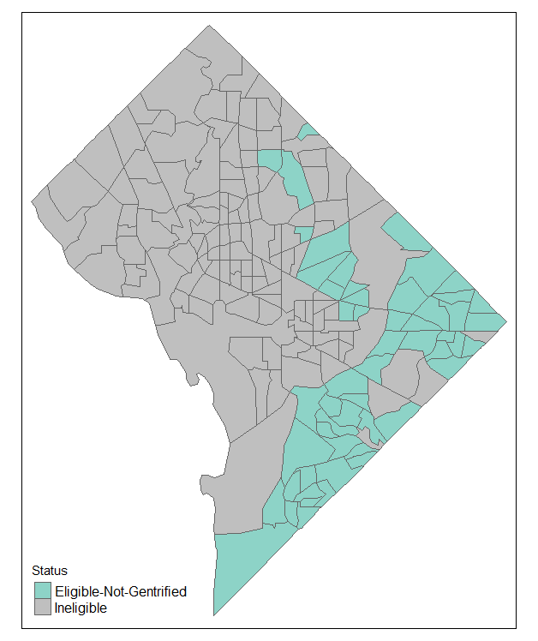
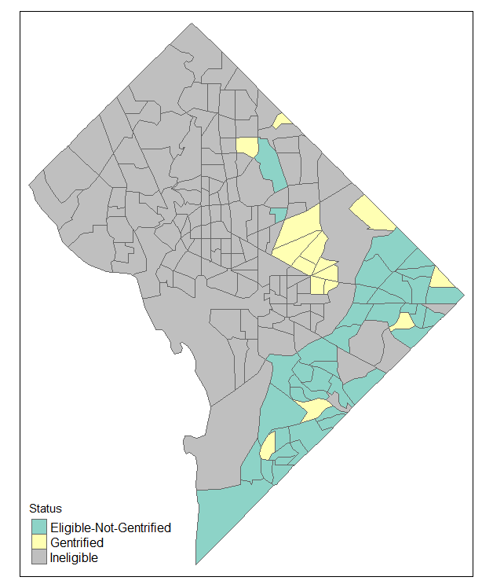
Eligible and Gentrified Census Tracts
In 2012:
54 eligible
In 2019:
15 gentrified
39 eligible but not gentrified
179 total tracts in DC in
2010 census
2012
2019

Slide 5
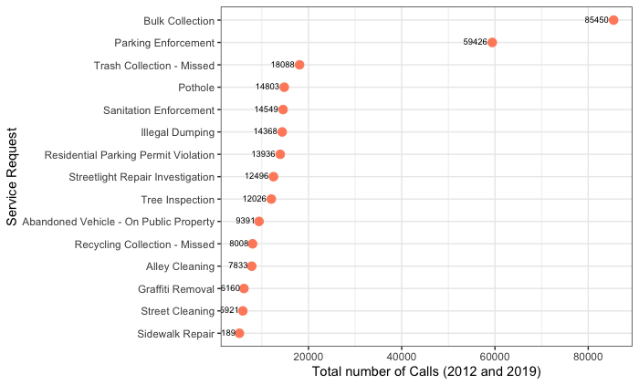
Initial Selection of Call Types and Frequencies

Slide 6
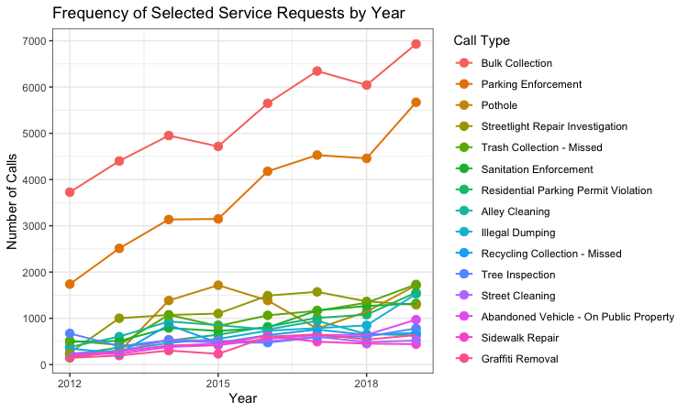
Trends in Selected Service Requests (2012 to 2019)

Slide 7
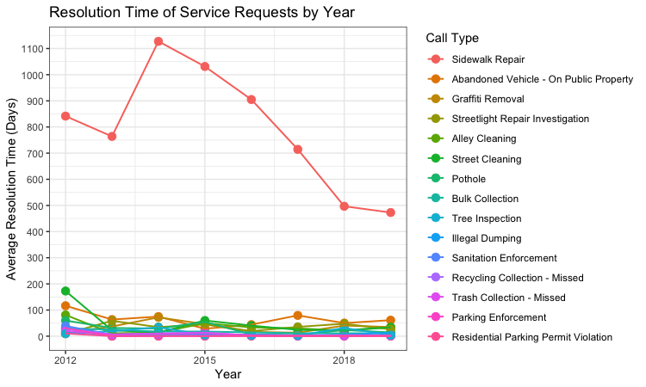
Trends in Selected Service Requests (continued)

Slide 8
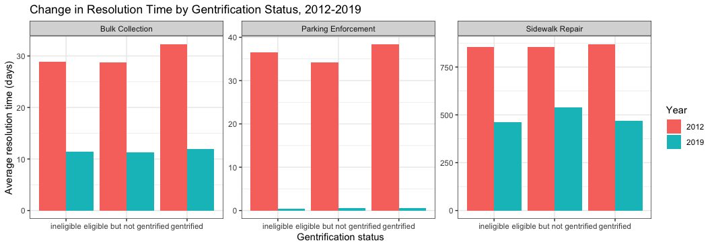
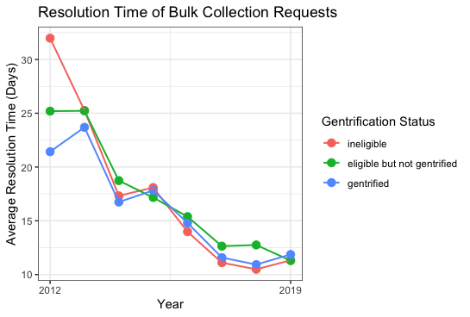
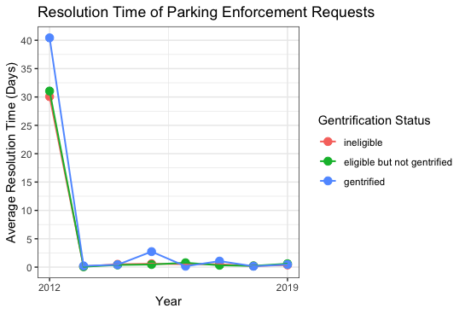
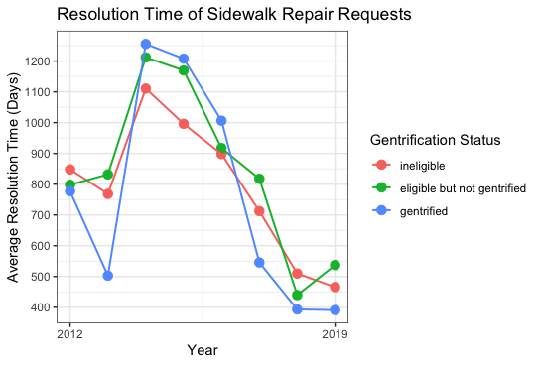
Trends in call types of special concern

Slide 9
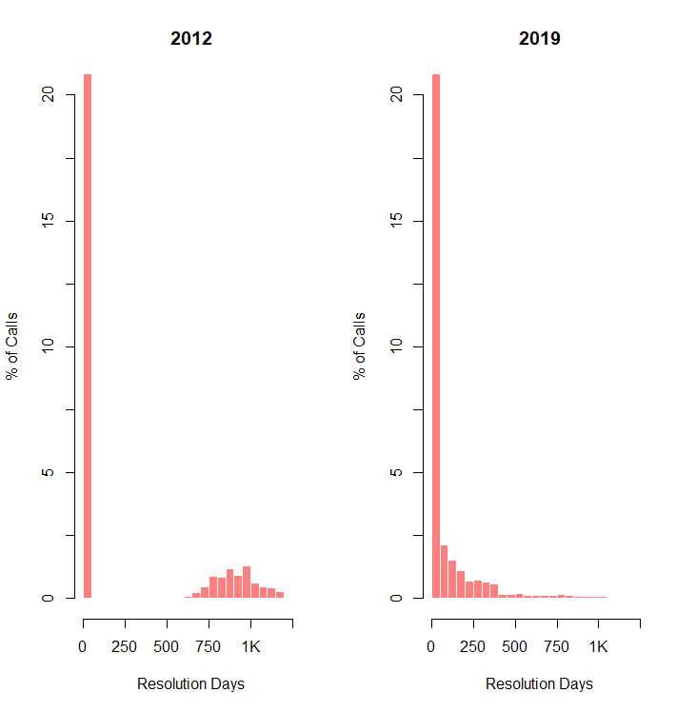
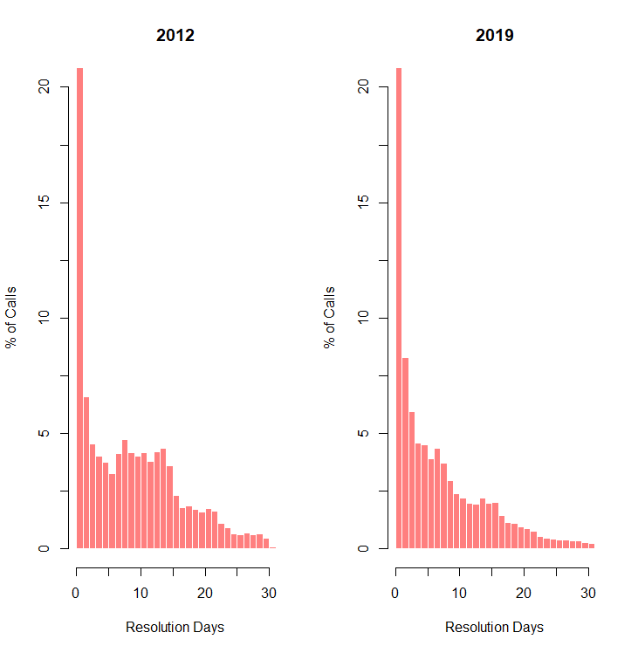
Decision to filter for resolution times of 31 days or less
Without Filter
With Filter

Slide 10
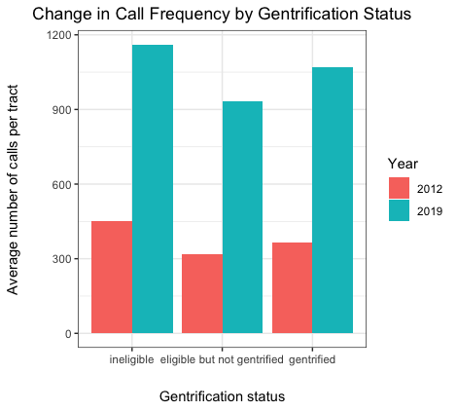
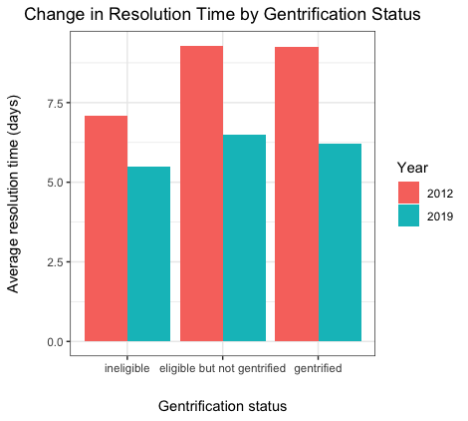
Changes by gentrification status (2012 vs. 2019)

Slide 11
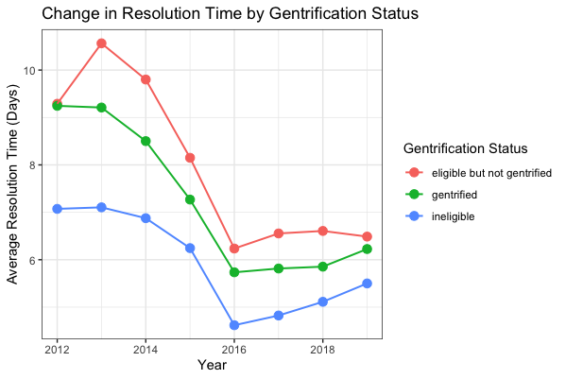
Change in resolution time by gentrification status, 2012 to 2019
Improvement
Ineligible tracts:
1.57 days
Eligible but not gentrified tracts:
2.80 days
Gentrified tracts:
3.02 days

Slide 12
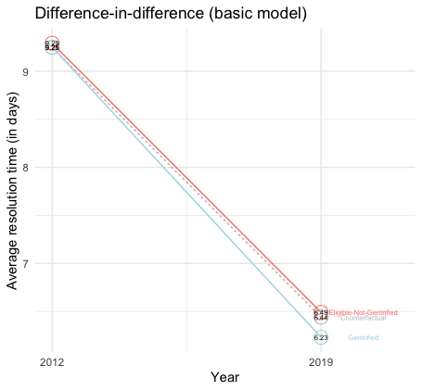
Difference-in-Difference (Basic Model)
(Treatment2019 – Treatment2012) – (Control2019 – Control2012)
(6.23 – 9.25 ) – (6.49 – 9.29 ) = – 0.22 days
(or 5 hours 17 minutes faster)
p-value = 0.0964
95% confidence interval: ( – 0.48 days, 0.04 days)

Slide 13
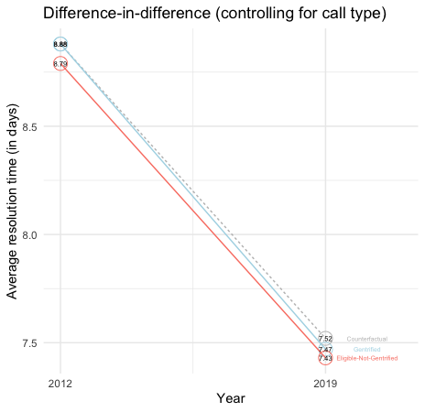
Difference-in-Difference (Controlling for Call Type)
(Treatment2019 – Treatment2012) – (Control2019 –Control2012)
(7.47 – 8.88 ) – (7.43 – 8.79) = – .05 days
(or 1 hour 12 minutes faster)
p-value = 0.624
95% confidence interval: ( – 0.24 days, 0.14 days)

Slide 14
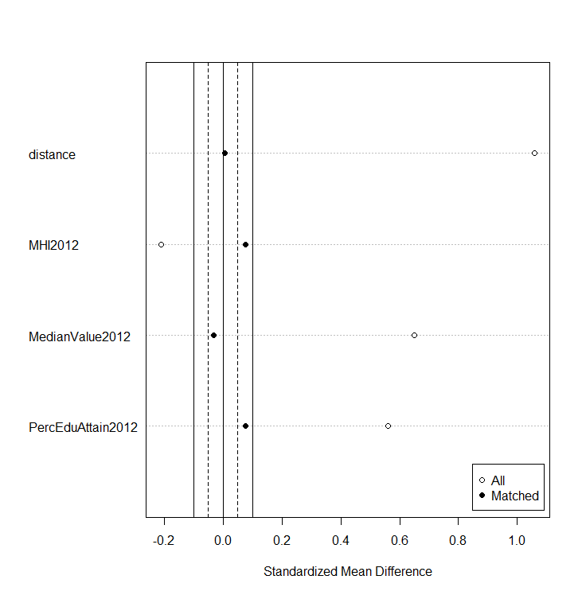
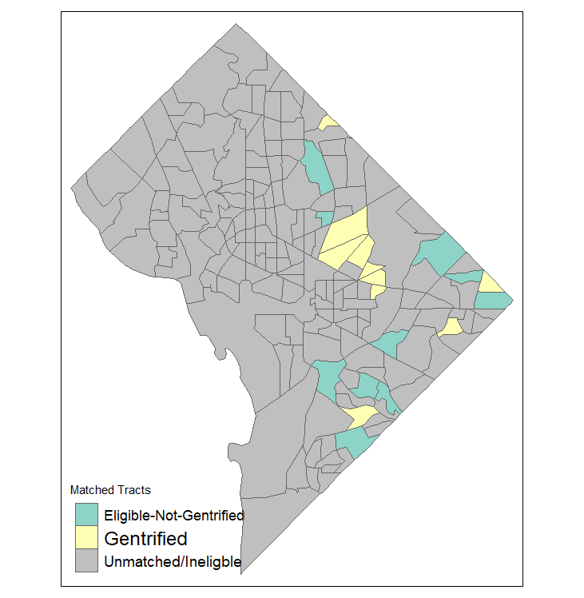
Matching Census Tracts

Slide 15
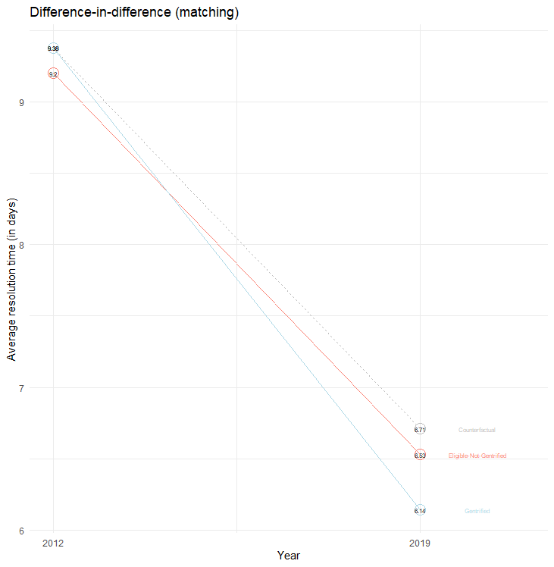
Difference-in-Difference (with Matching)
(MatchTreat2019 – MatchTreat2012) – (MatchControl2019 – MatchControl2012)
(6.14 – 9.38 ) – (6.53 – 9.20 ) = – 0.57 days
(or 13 hours 40 minutes faster)
p-value = 0.0065
95% confidence interval: ( – 0.98 days, -0.16 days)

Slide 16
Conclusions
When comparing all gentrified and eligible-but-not-gentrified census tracts, there is weak evidence that gentrification had a mild impact on 311 call resolution times (significant at the p = 0.1 level).
However, this effect disappears when controlling for call type, which suggests that the mix of calls was responsible for most of the variation in resolution-time improvement across gentrification statuses.
On the other hand, when we compare 10 gentrified tracts with the 10 eligible-but-not-gentrified tracts that most closely resemble them in pre-gentrification attributes, we see evidence that gentrification did have an impact on call resolution times (p = 0.0065).

Slide 17
Limitations
Parallel trends pre-2012
Definition issues
Opportunities for further research
Alternative study design
Spillover effects

Slide 18
Data Sources
311 City Service Requests, 2010 – 2019 (opendata.dc.gov)
American Community Survey, 2010 – 2019 (https://www.census.gov/programs-surveys/acs)

